Slide 1

Is Northern Ireland Different? AN Investigation into migration
Dr Owen Sims
October 2019

Slide 2
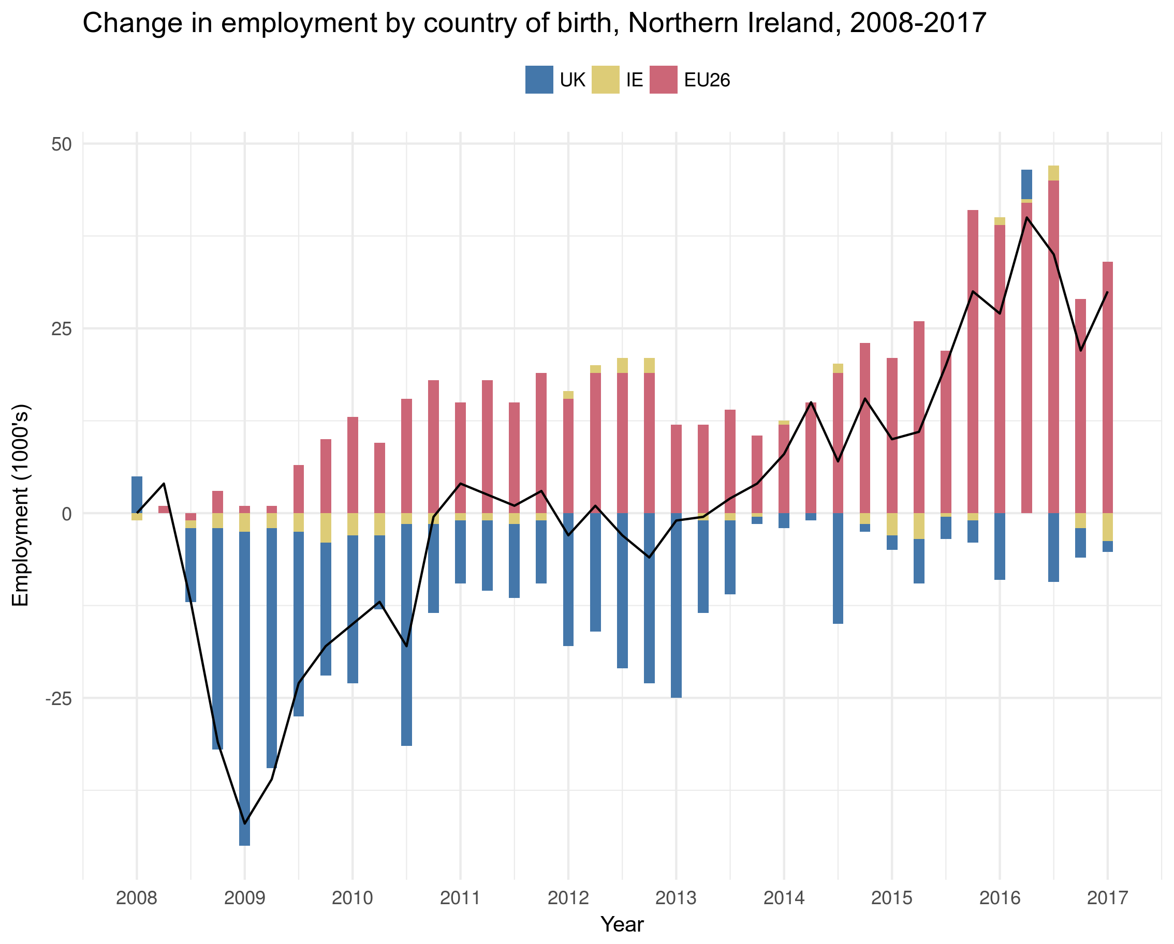
Contribution to employment
UK Home Office proposed a £30,000 salary threshold for all migrants (EU or otherwise) to enter the economy. How will this impact NI?
The global financial crisis (2008/2009) brought with it a structural change to the make-up of the NI labour market.
Over the past decade migrant workers from EU economies have driven employment in NI beyond the pre-crisis levels.
Large concentration in manufacturing, construction, and tourism.

Slide 3
Relatively large dependence on EU26 workers
Proportion of migrant workers from EU26 nations and Rest of World (RoW), NI and UK, 2018
65% of all migrant workers in Northern Ireland are from EU26 nations, compared to the 40% across the UK as a whole.
As a consequence, over 98% of businesses in Northern Ireland have not engaged with the Tier 2 visa system, instead depending on the free movement of labour across the EU.

Slide 4
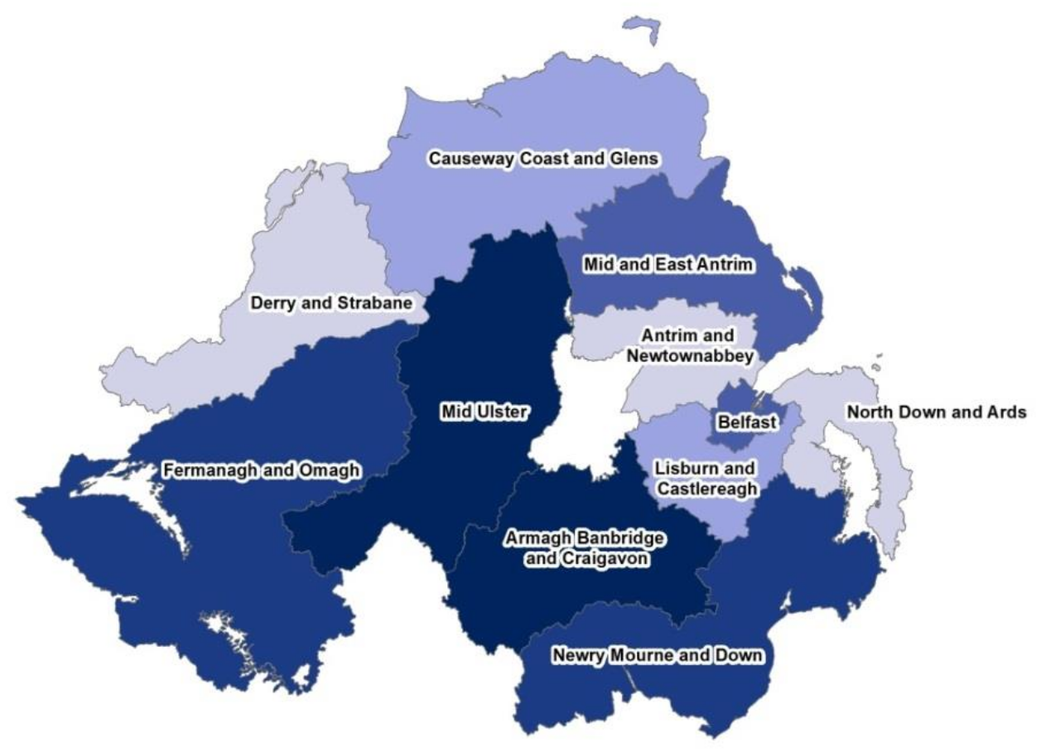
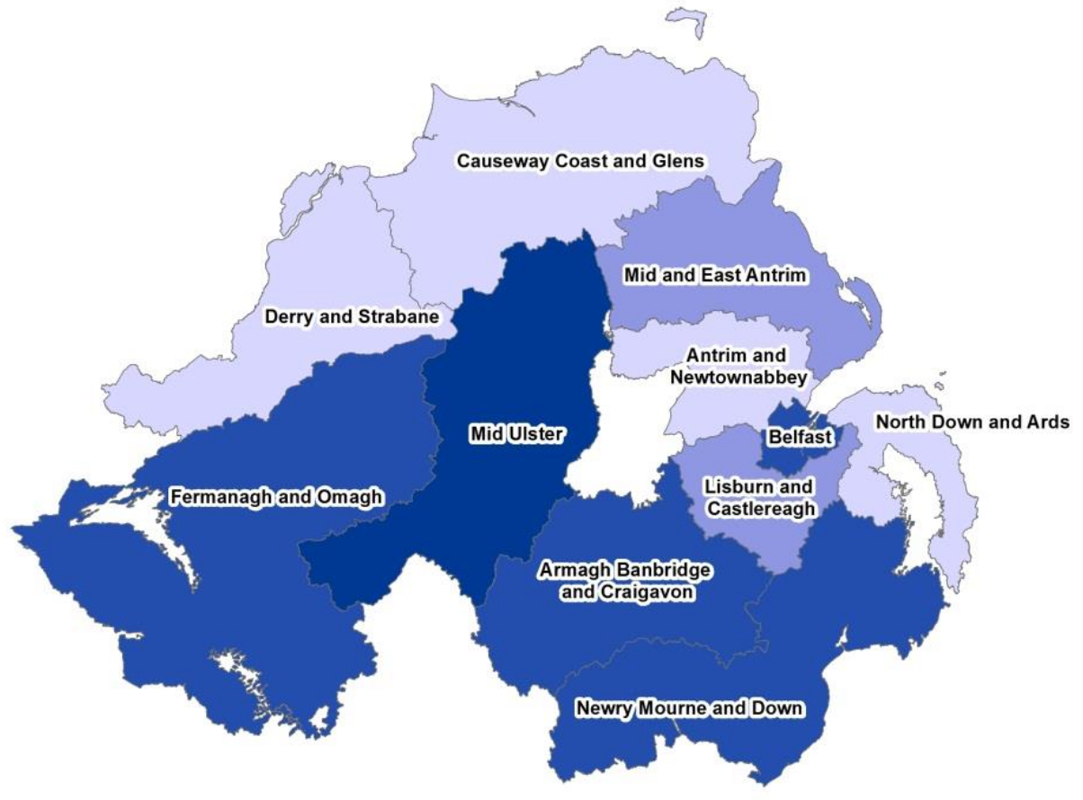
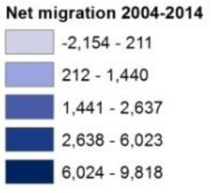
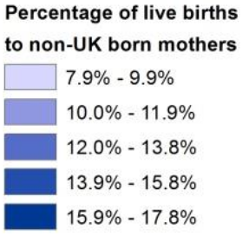
Geography of Migrant inflows
Net migration by district, 2006–2016
Births to non-UK mothers by district, 2006–2016
Overall, 8% of Northern Ireland’s population was born overseas: 5.5% from the EEA, and 2.5% from the rest of the world.
Importantly, migrants largely stay and form social roots when they come to Northern Ireland.

Slide 5
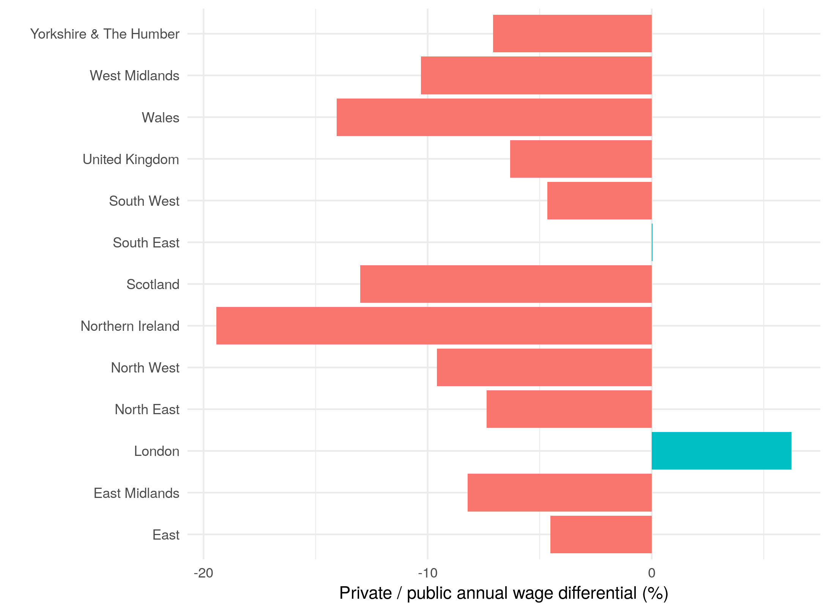
Private-Public sector differential
Public sector wages tend to distort the averages for NI compared to the rest of UK.
In 2019, median gross annual wages in the private sector were almost 20% lower in NI compared to public sector wages. NI is a real anomaly.
Taking this into account, the median (mean) wage in NI private sector is £25,525 (£30,865).
Compared to the UK’s £29,932 (£38,467).

Slide 6
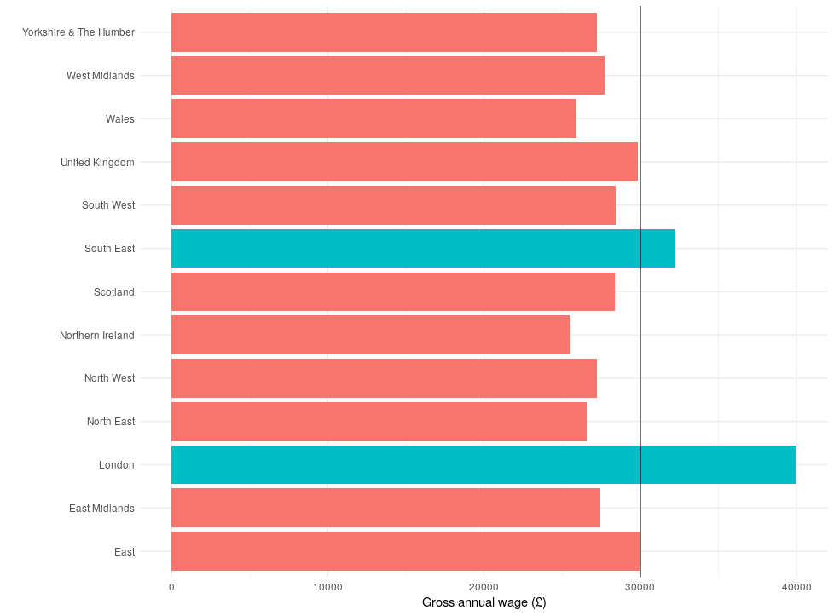
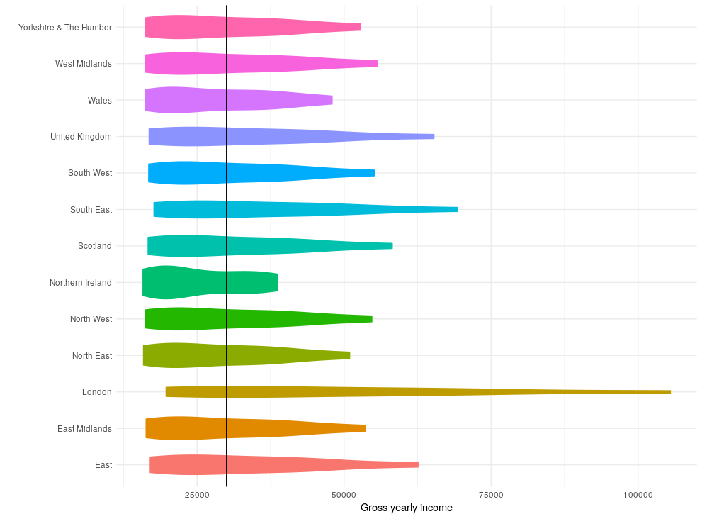
private wages & distributions
Annual full-time private salaries for all UK regions
Annual full-time private salary distribution for all UK regions
NI has the lowest median full-time annual salary – around 15% lower than UK average.
Also, NI has a truncated salary distribution relative to all other regions. Makes it more difficult to attain a salary over the proposed £30,000 threshold in many industries.

Slide 7
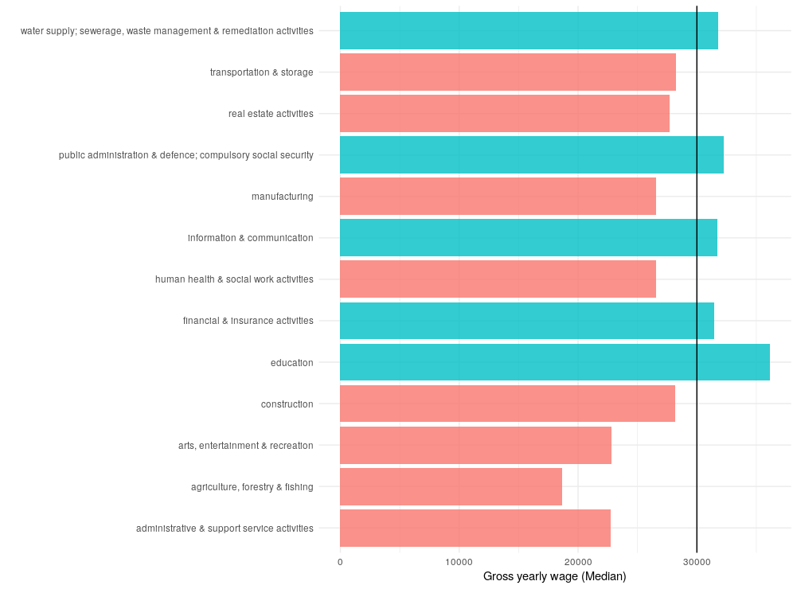
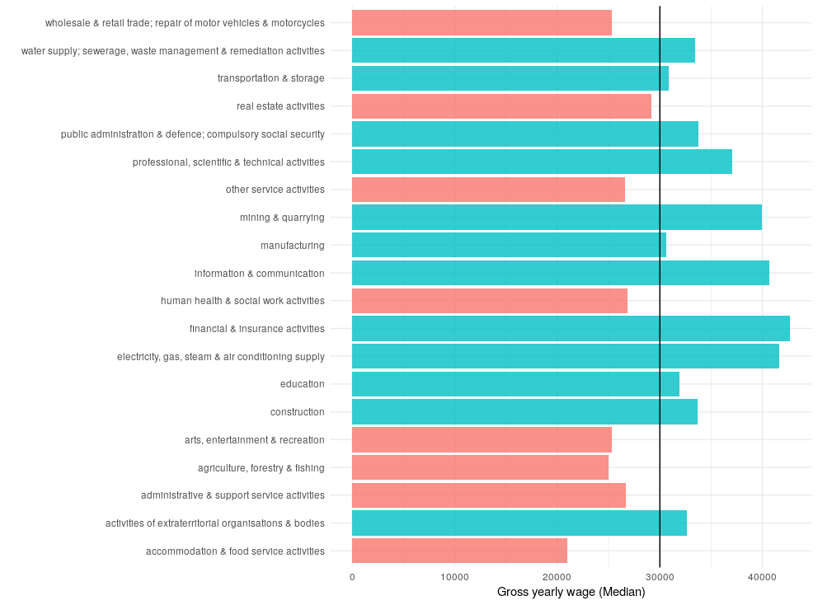
Full-Time Annual industry salary averages
Annual full-time private salaries for NI industries
Annual full-time private salaries for UK industries
Many more industries are at risk in NI than the UK on average: Agri, Manufacturing & Construction.
Moreover, note that some NI industries are not well represented with the ASHE data.

Slide 8
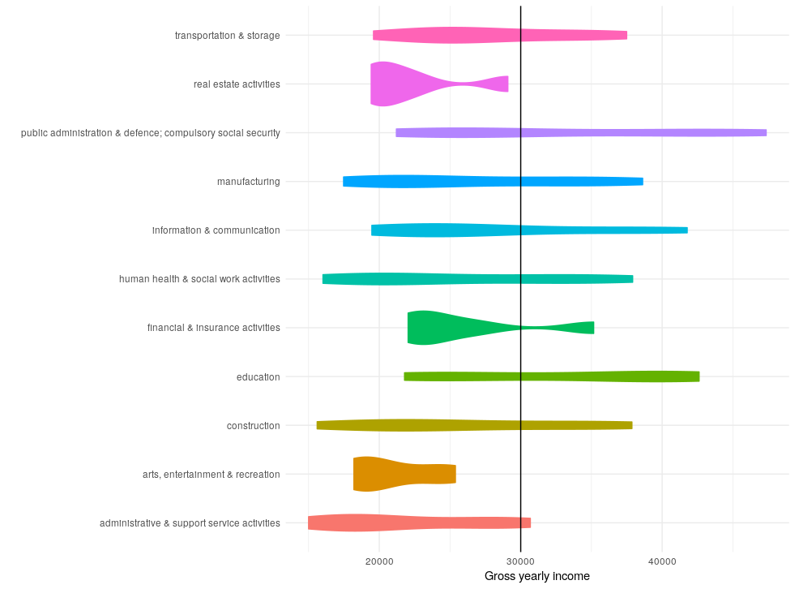
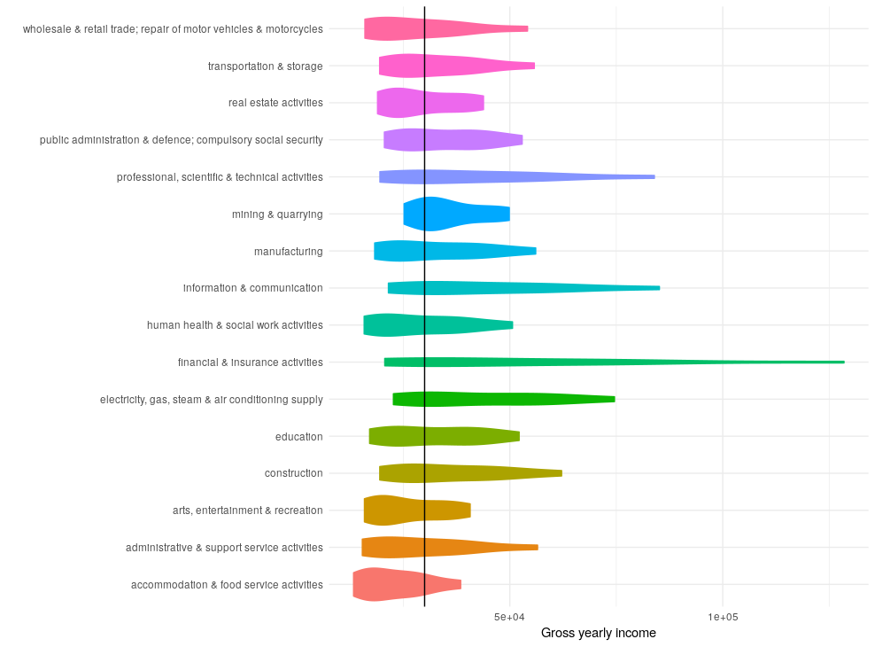
Full-Time Annual industry salary Distributions
Annual full-time private salary distributions for NI industries
Annual full-time private salary distributions for UK industries
Across the UK as a whole, workers salaries could surpass the £30,000 threshold even at relatively junior roles. Not so much in Northern Ireland; on average a worker would need to surpass the 65th percentile.

Slide 9
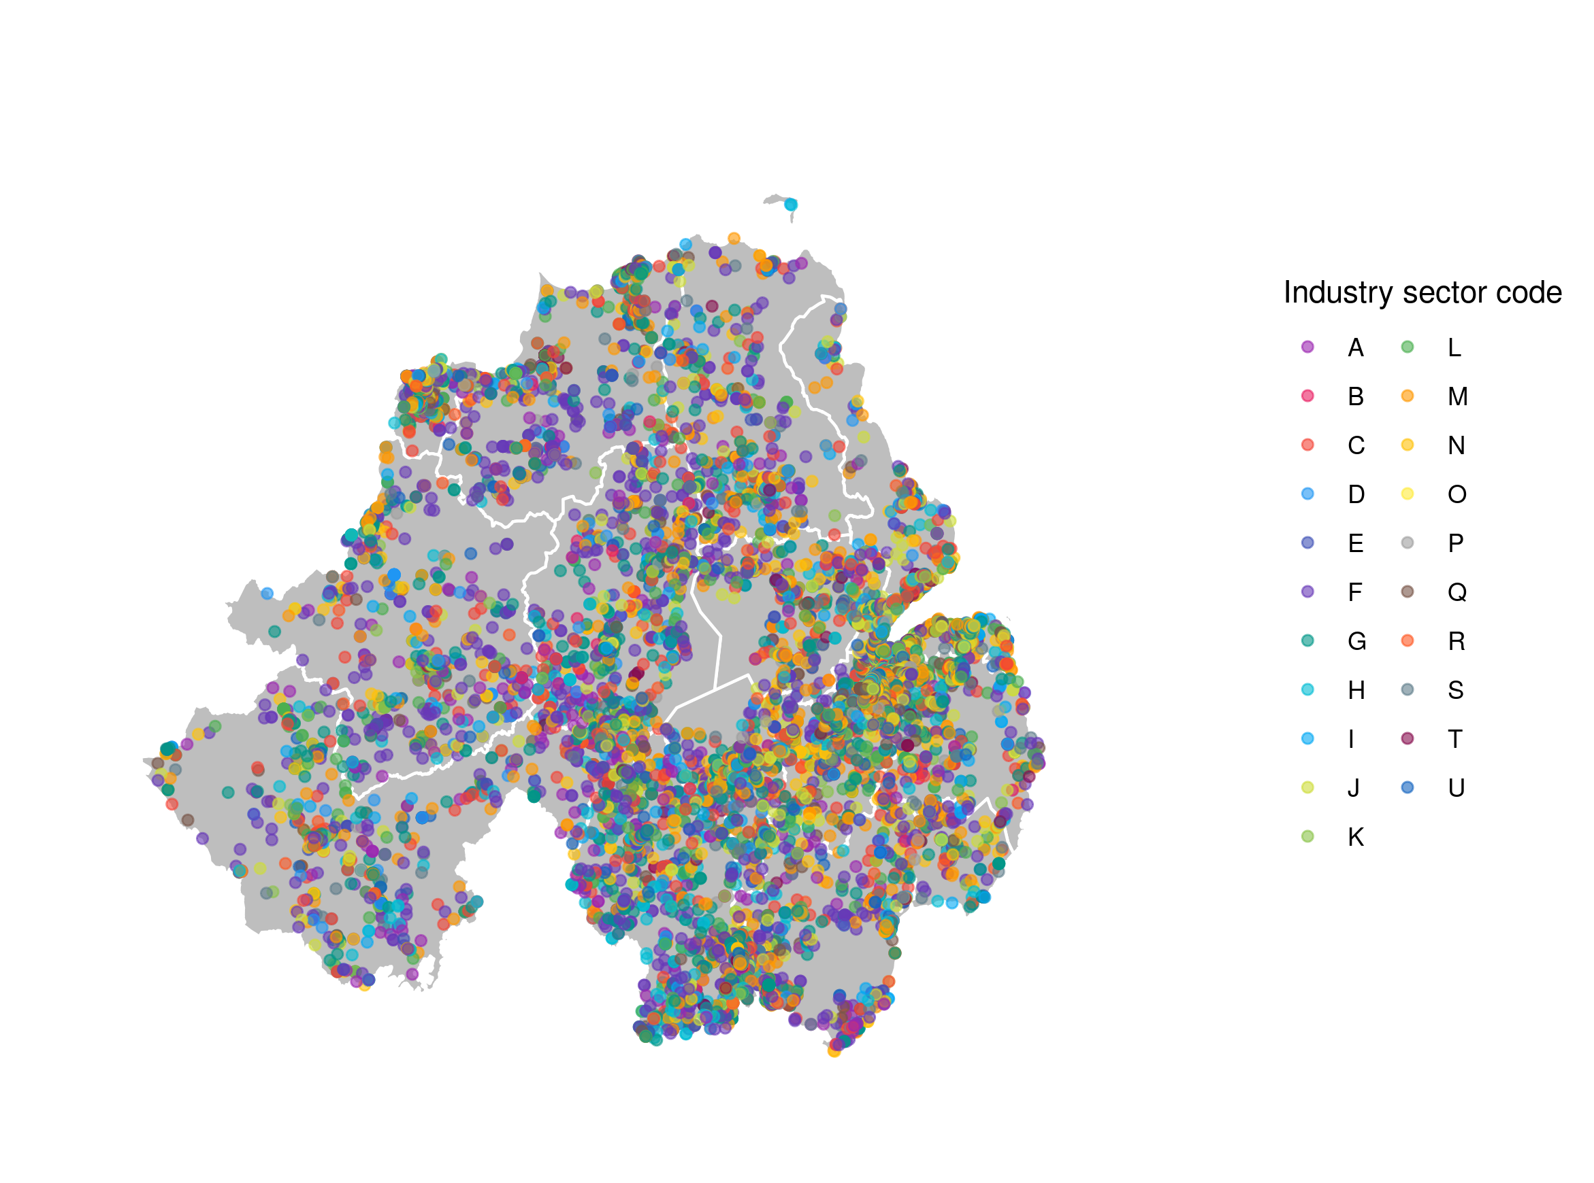
Most impacted areas in Northern Ireland (1)
Geolocation of all NI companies registered with Companies House, 2019
Companies House have a very nice API, which can be used to request data on all firms operating in NI and across the UK.
Each company registers a 5-Digit SIC code, which can be aggregated up to the industry sectors, like, Communication and Information.
Also able to extract balance sheet data (by parsing PDFs).

Slide 10
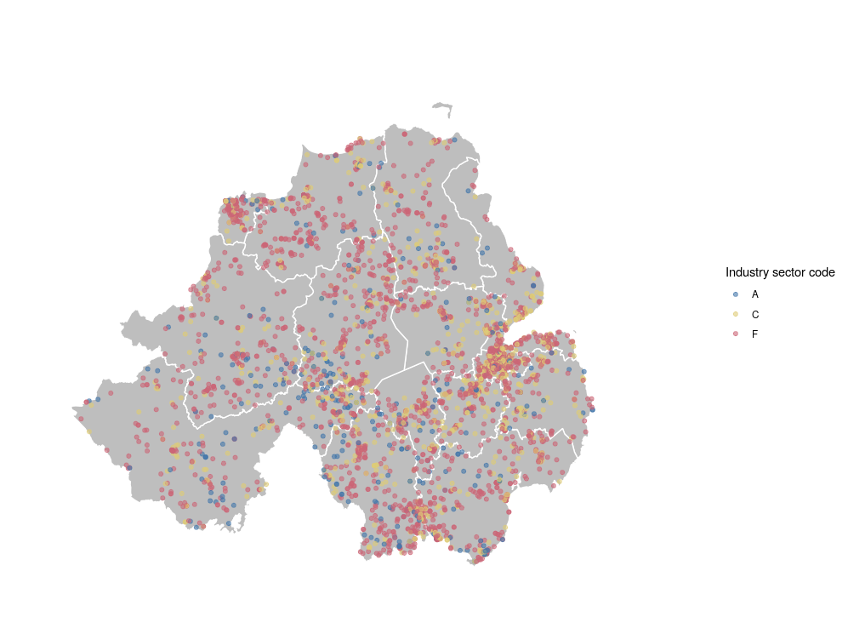
Most impacted areas in Northern Ireland (2)
Geolocation of all agriculture, manufacturing & construction firms, 2019
Construction companies dominate the landscape of NI. But each one is relatively small.
Mid-Ulster, Armagh & Banbridge and Border areas show concentrations of relatively large manufacturing and agri firms (see yellow circles).
Notably, also areas that have high levels of migrant inflow (slide 4).
Agriculture
Manufacturing
Construction

Slide 11
Most impacted areas in Northern Ireland (3)
Direct number of migrant worker jobs potentially at risk per district
19% of manufacturing labour are migrant workers.
12% of distribution, hotels and restaurant workers are migrants.
6% of construction labour are migrant workers.
Over 10,000 migrant manufacturing jobs would be at risk of having a salary of under £30,000.

Slide 12
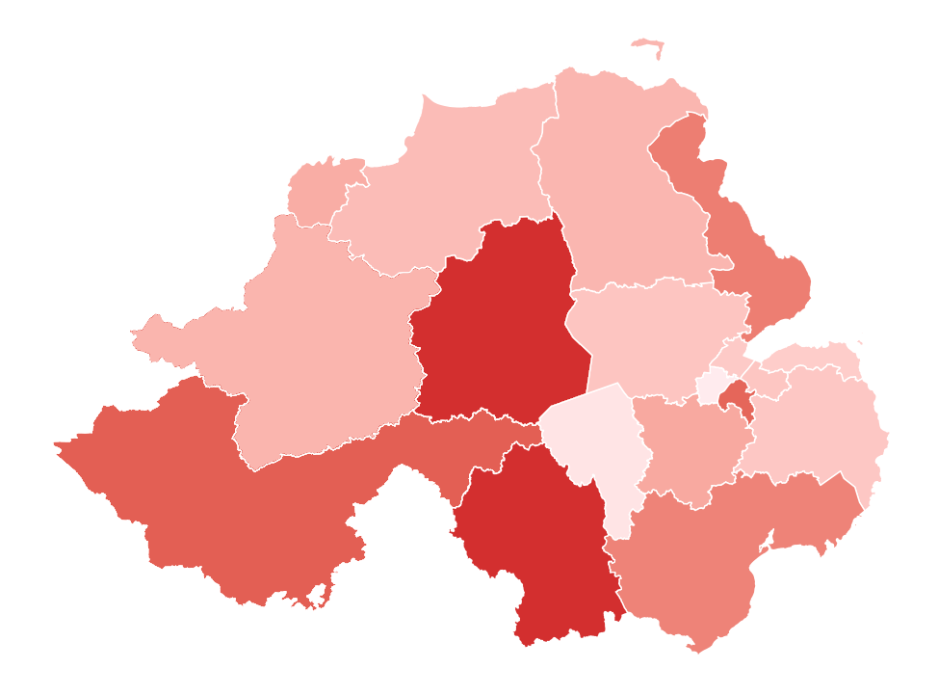
Most impacted areas in Northern Ireland (4)
Heatmap of districts most impacted by proposed threshold
Two things to note:
Manufacturing & construction have relatively high output and GVA multipliers.
That the most impacted areas are also areas of concern that the Department for the Economy have noted for a No Deal Brexit.
High levels of economic detriment in mid-Ulster and Border Areas can have unravelling effects.
Combined with potential smuggling and black market activity.

Slide 13
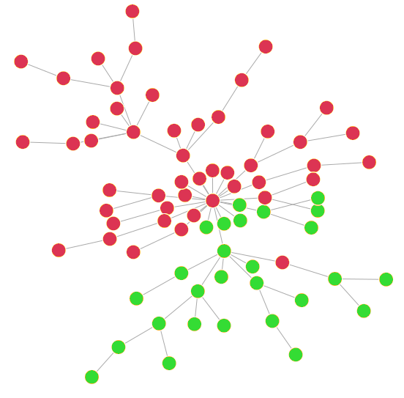
All-island supply chains are important!
Supply and distribution network of NI agri-food and manufacturing business
Geography matters!
Firms in Northern Ireland work in an all-island basis with integrated supply chains and a pooled labour market.
Consider the example of an agri-food company with supply chain an distribution network in both NI and Ireland.
Firms in NI rely on a level-playing field for labour so that bottlenecks do not appear in NI supply chains.
UK firm
Irish firm

Slide 14
Many EU26 migrants have already left NI…
Number of migrant workers in Northern Ireland, 2015—2018
EU referendum
Brexit is already happening!
Since the EU Referendum was called and voted upon, there has been a significant decline of EU26 migrants in NI.
Fallen from 54,000 to 38,000 (29.63%) in two years.
Multiple reasons:
Growing economies in Eastern European nations.
Perception and culture.
Weakening sterling.
Draw from the Republic of Ireland (poaching).

Slide 15
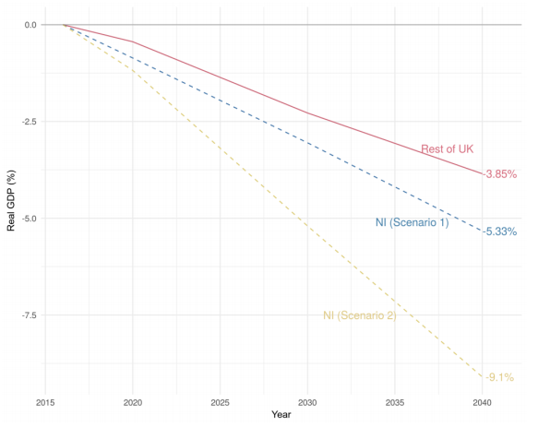
opportunity cost looks to escalate
The CBI NI publication All Together Better measured the contribution of EU26 migrant labour to the NI economy.
Found that:
If the inflow of EU labour fell by 50% there would be a 5.33% impact on the NI economy by 2041.
That’s about £20,000 of lost income per capita by 2041.
If the inflow of EU labour fell by 75% there would be a 9.1% impact on the NI economy by 2041.
That’s about £38,000 of lost income per capita by 2041.

Slide 16
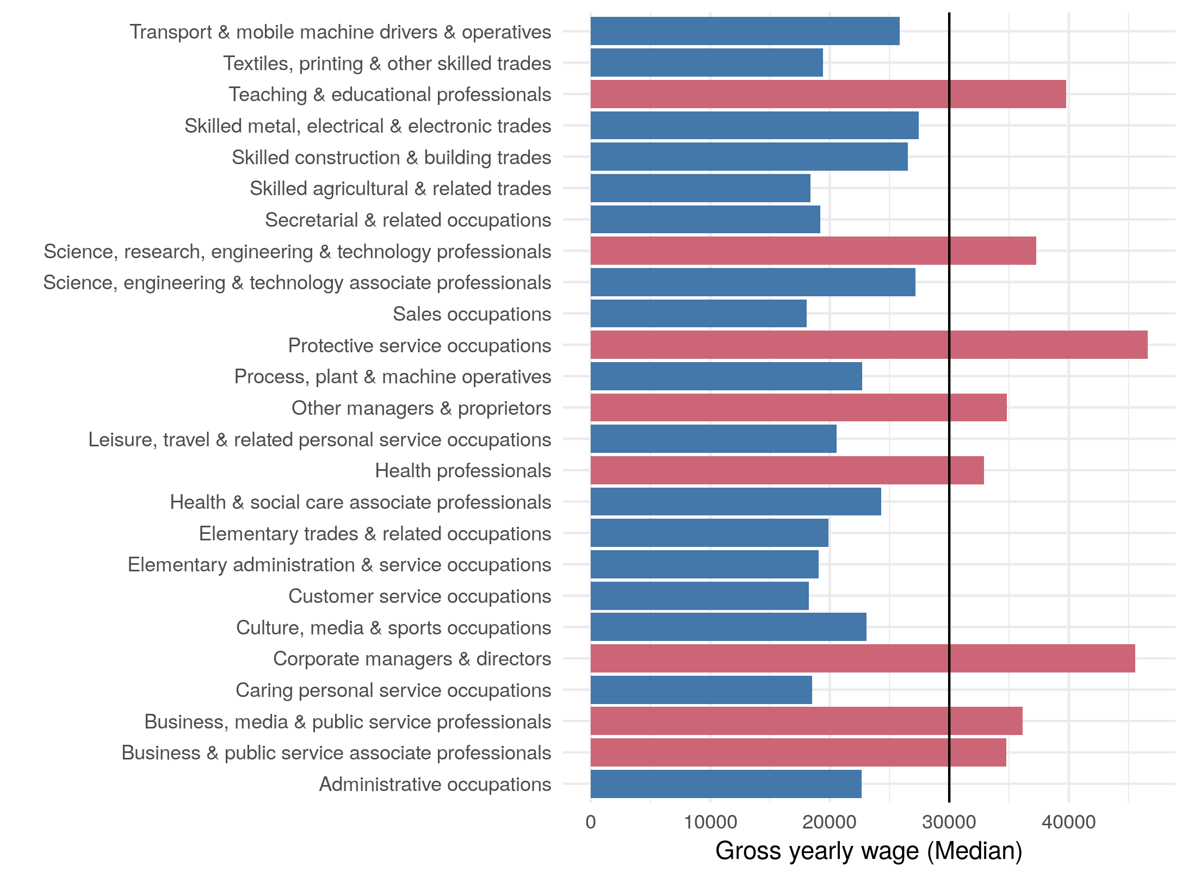
opportunity cost looks to escalate
Average wages for workers (SOC code 2) in Northern Ireland
The vast majority of occupations will not be covered at the proposed threshold.
The productivity loss of a temporary workers scheme would be significant.
Taking wage differentials of skilled workers and the cost of training; productivity lost would be between £10,000 and £18,000 per worker (depending on industry).
There would be a case for a pathway to a Skilled Worker Route.

Slide 17
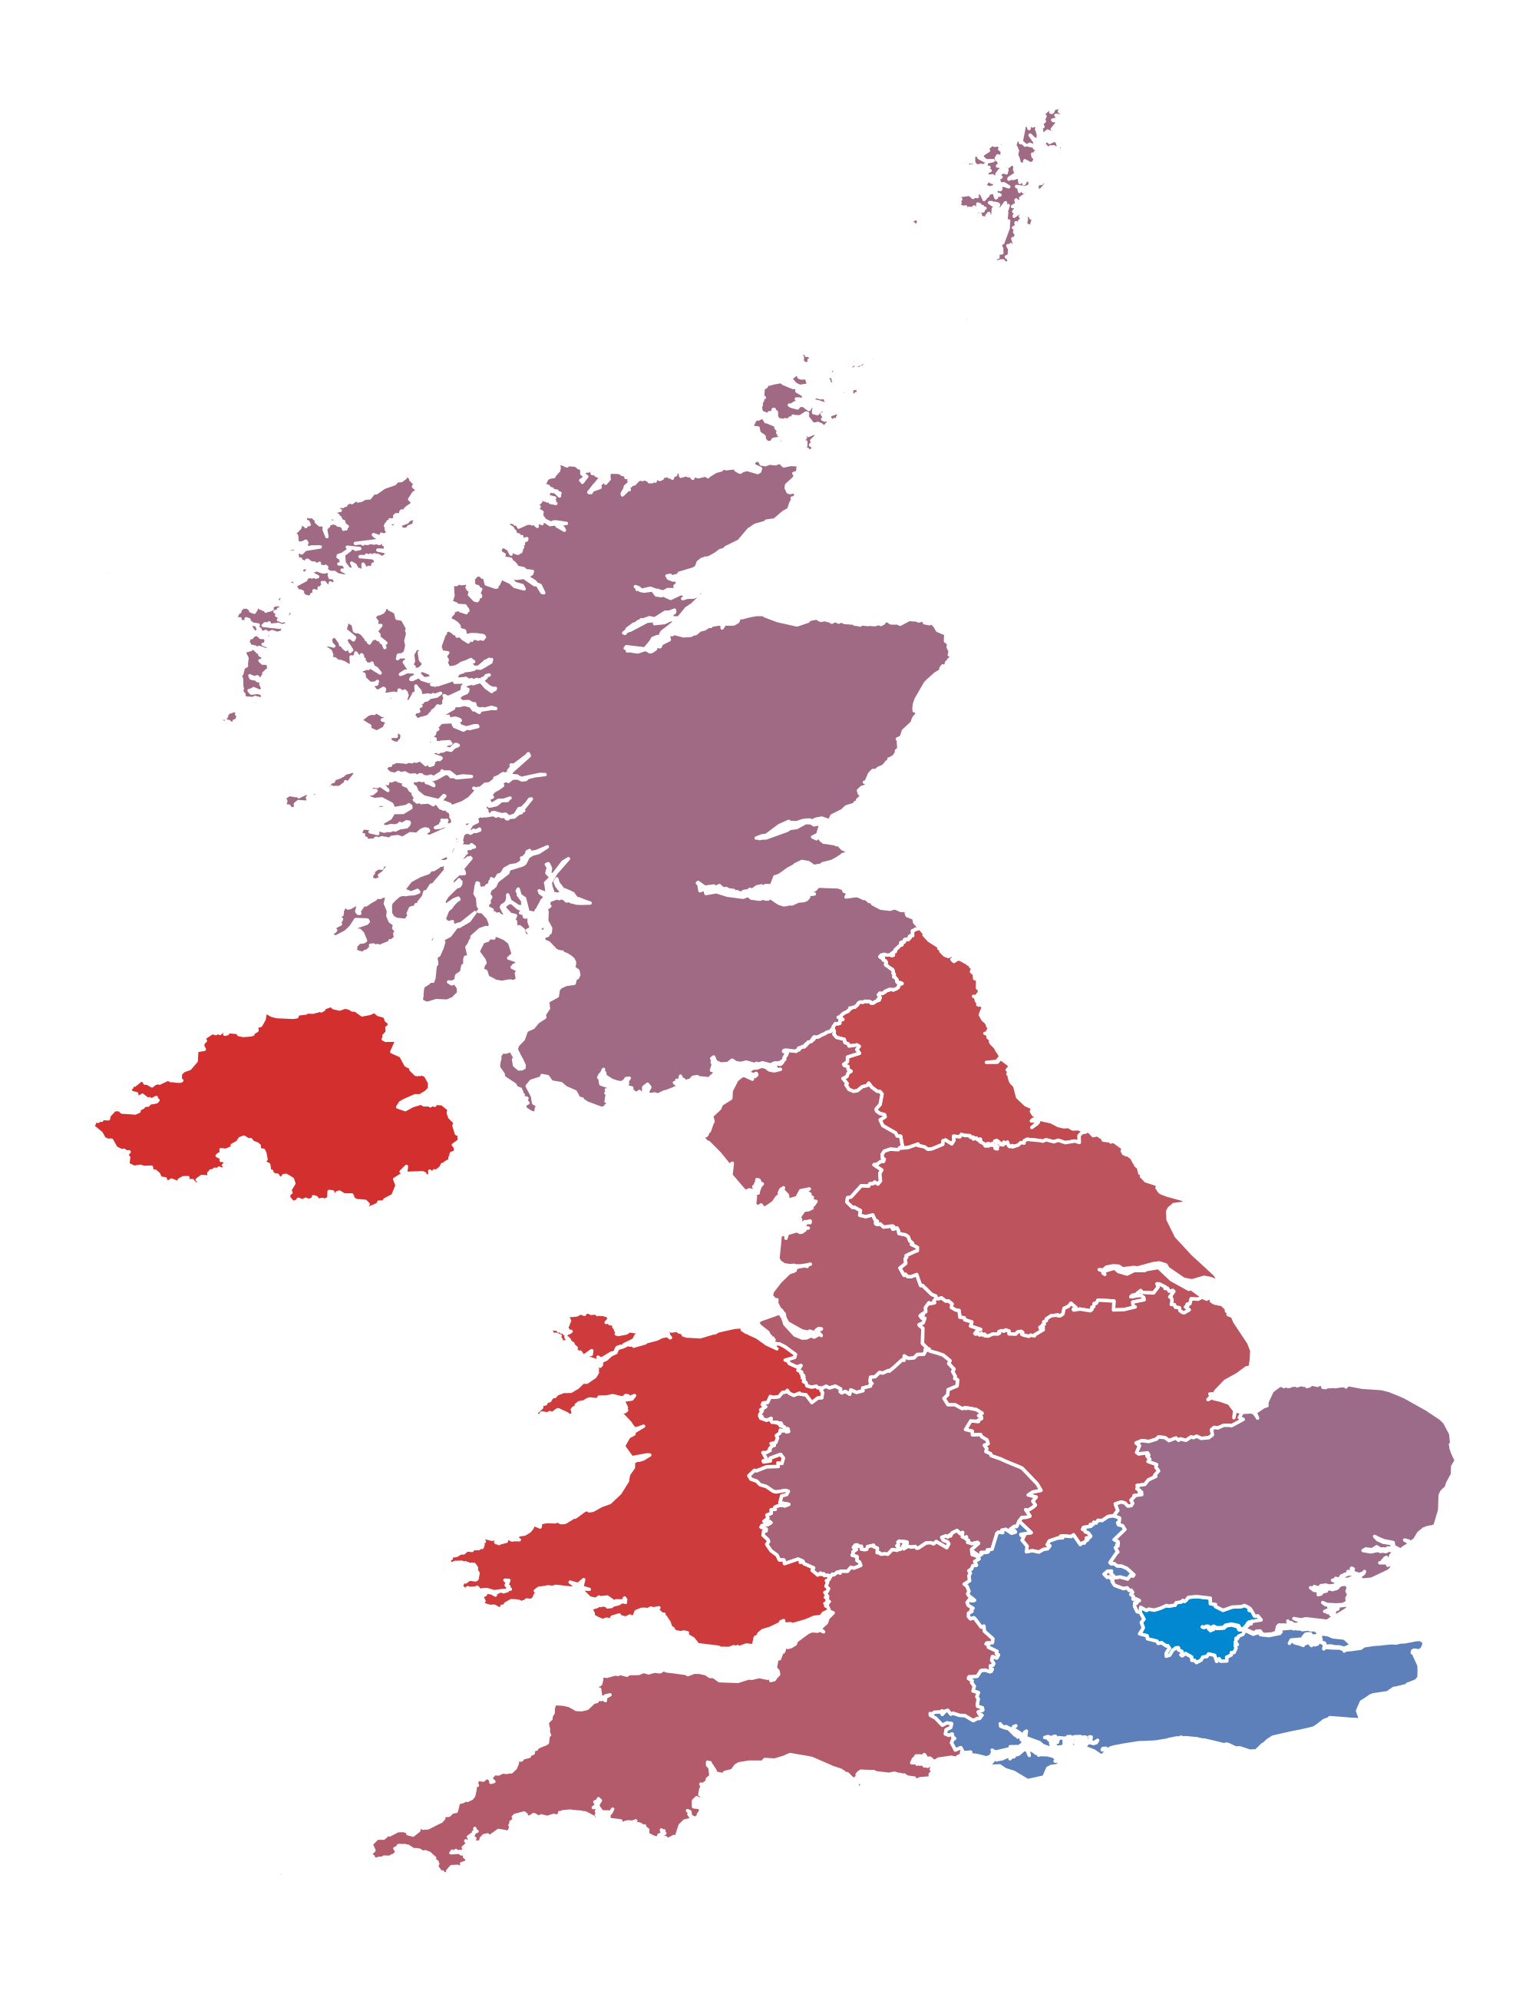
So, Is Northern Ireland Different?
Yes. A number of things are clear:
The proposed £30,000 salary threshold is not achievable by many NI employers.
Manufacturing, construction, tourism, agri-food, and social care are most at risk.
These are also sensitive areas in the situation of a hard Brexit or No Deal.
Other regions will also see an impact; but labour is much more immobile in NI.
NI has a land border with another EU nation.
Border regions are exposed.
Supply chains are integrated and labour is pooled across the island or Ireland.
Proposed 12 month temporary worker period is too short – NI becomes a training ground for Ireland.
Pathway for a Skilled Worker seems achievable!

